Slide 1


United Curriculum
Primary Geography

Slide 2
Principles of the Geography Curriculum
The United Curriculum for geography provides all children, regardless of their background, with:
Relevant and coherent substantive knowledge of the world, which is built gradually using subject-specific pedagogy from EYFS to Year 6 and beyond.
Substantive knowledge – both conceptual and procedural – is selected to build pupils’ understanding of three geographical vertical concepts:
  Space and Place
    Developing an understanding of space through ideas related to location, distribution, pattern and distance.
    Developing a sense of place and character through ideas related to identity, home, community, landscapes and diversity, and examining a range of case studies from across the globe.
  Physical Processes
    How the Earth’s natural processes shape and change the surface of the Earth. This includes both Geology & Earth Science aspects, such as the structure of the Earth and physical features we see on the land, as well as Environmental Science aspects, such as the weather and our changing climate. Both of these are threaded through the science curriculum too.
  Human Processes
    The processes and phenomena that are caused by or relate to people, including our Use of Resources; the distribution and changes to the Population & Communities; and the features of the Economy & Development.
A balanced view of the countries of the world, to address or even preempt misconceptions and negative stereotypes.
Explicit teaching of core disciplinary knowledge, and the ability to approach challenging, geographically-valid questions. Geographical enquiry skills have been sequenced across the year groups and, where appropriate, review and build on relevant knowledge that is first taught in mathematics or science, such as interpreting line graphs or setting hypotheses.
Opportunities to undertake fieldwork, outside the classroom and virtually. Fieldwork is purposeful, and either gives pupils the opportunity to put into practice relevant disciplinary knowledge or to reinforce their substantive knowledge.

Slide 3
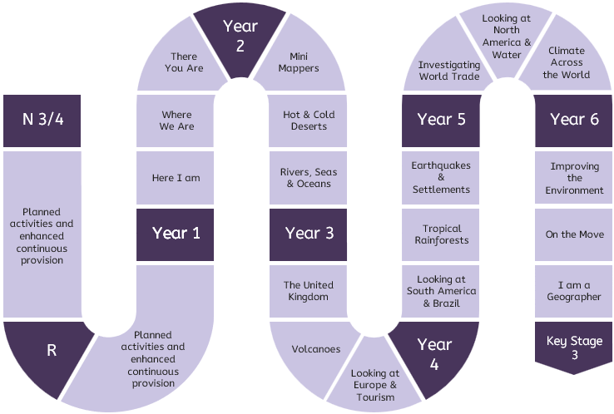
United Curriculum: Geography
new
Year 1
Key Stage 3

Slide 4
United Curriculum: Geography
 | Year 1 | Year 2 | Year 3 | Year 4 | Year 5 | Year 6
Autumn | Here I am [Aut1] Locating our school in our local area, and identifying local physical and human features on a map and during fieldwork | Mini mappers Studying the human and physical geography of the local area with an introduction to scale and fieldwork | United Kingdom [Aut1] Locating the UK, Great Britain and the British Isles, and regions and counties; identifying physical features and regeneration of one region | Looking at South America and Brazil Locating lines of longitude and latitude and South America; understanding Brazil’s physical features and climate, and its human settlements in Rio de Janeiro | Investigating world trade [Aut1] Understanding the distribution of the world’s natural resources and how these are traded between places across the world | Improving the environment [Aut2] Recognising the importance of renewable energy through investigating wind power. Learning about reducing waste, and the actions that humans can take to improve the environment
Spring | Where we are Locating our local area in the UK; identifying the four countries of the UK; some key human and physical features | Hot and cold deserts [Spr1] Locating hot and cold deserts, and identifying common physical and human features | Volcanoes Understanding the structure of the Earth; how volcanoes are formed; and the impacts they can have on human settlement using case studies of Etna and La Soufriere | Tropical rainforests [Spr2] Understanding the key features of a rainforest ecosystem, the contributions they make to the world and the threats they face (using the Amazon Rainforest) | Looking at North America and water Understanding the water cycle and the distribution of the world’s water; examining the physical and human geography around rivers in North America | On the move [Spr1] Understanding push and pull factors in migration from the Northern Triangle to the USA, and from Syria to countries in Europe; understanding the benefits of migration to the UK
Summer | There you are Understanding where we live on the global scale; locating continents; and comparing the human and physical features of an area in the UK with an area in Kenya | Rivers, seas and oceans Locating the seas around the UK and oceans of the world. Identifying physical and human features around rivers and coastal areas | Looking at Europe and tourism [Sum1] Comparing the human and physical features of the Alps, the Amalfi Coast and a local area, and exploring the impact of tourism in these areas | Earthquakes and human settlements Understanding why earthquakes take place and what effects they had in Haiti and Japan | Climate across the world [Sum1] Understanding climate zones, biomes and vegetation belts, and the effects of global warming on vulnerable biomes | I am a geographer Posing questions, completing fieldwork and presenting a geographical investigation
Most of the case studies used come from the UK, Europe or North or South America, as per the requirements of the National Curriculum.
However, teachers may choose to change the highlighted case studies to reflect the interests or backgrounds of pupils.

Slide 5
Alignment with the National Curriculum (KS1)
The below table outlines where the statutory content from the National Curriculum is first taught across KS1. The curriculum has been sequenced so that much of the content is reviewed in subsequent units.
Locational knowledge
Name and locate the world’s seven continents and five oceans | Y1 Sum: There you are
Name, locate and identify characteristics of the four countries and capital cities of the United Kingdom and its surrounding seas | Y1 Spr: Where we are
Place knowledge
Understand geographical similarities and differences through studying the human and physical geography of a small area of the United Kingdom, and of a small area in a contrasting non-European country | Y1 Sum: There you are
Human and physical geography
Identify seasonal and daily weather patterns in the United Kingdom | Y1 Aut2 Science: Seasonal changes
Identify the locations of hot and cold areas of the world in relation to the Equator and the North and South Poles | Y2 Spr: Hot and cold deserts
Use basic geographical vocabulary to refer to: Key physical features, including: beaches, cliffs, coasts, forests, hills, mountains, seas, oceans, rivers, soil, valleys, vegetation, seasons and weather Key human features, including: cities, towns, villages, factories, farms, houses, offices, harbours and ports | Y1 Aut: Here I am Y1 Spr: Where we are Y2 Sum: Rivers, seas and oceans
Geographical skills and fieldwork
Use world maps, atlases and globes to identify the United Kingdom and its countries, as well as the countries, continents and oceans studied at this key stage | Y1 Sum: There you are Y2 Sum: Rivers, seas and oceans
Use simple compass directions (north, south, east and west) | Y2 Aut: Mini mappers
Use locational and directional language (for example, near and far; left and right), to describe the locations of features and routes on a map | Y1 Aut: Here I am
Use aerial photographs and plan perspectives to recognise landmarks and basic human and physical features | Y2 Sum: Rivers, seas and oceans
Devise a simple map; use and construct basic symbols in a key | Y2 Aut: Mini mappers
Use simple fieldwork and observational skills to study the geography of the school and its grounds and the key human and physical features of its surrounding environment | Y1 Aut: Here I am Y2 Aut: Mini mappers

Slide 6
Alignment with the National Curriculum (KS2)
Locational knowledge
Locate the world’s countries, using maps to concentrate on their environmental regions, key physical and human characteristics, countries and major cities: Europe North America South America | Y3 Sum: Looking at Europe and tourism Y5 Aut: Investigating world trade Y4 Aut: Looking at South America and Brazil
Name and locate countries and cities of the United Kingdom, geographical regions and their identifying human and physical characteristics, key topographical features (including hills, mountains, coasts and rivers) and land-use patterns; and understand how some of these aspects have changed over time | Y3 Aut: UK Y5 Spr: Looking at North America and water
Identify the position and significance of latitude, longitude, the Equator, the Northern Hemisphere, the Southern Hemisphere, the Tropics of Cancer and Capricorn, the Arctic and Antarctic Circles and the Prime Meridian | Y4 Aut: Looking at South America and Brazil
Place knowledge
Understand geographical similarities and differences through the study of the human and physical geography of a region of the United Kingdom, a region in a European country and a region within North or South America | Y5 Spr: Looking at North America and water
Human and physical geography
Describe and understand key aspects of physical geography, including: Climate zones, biomes and vegetation belts Rivers Volcanoes Mountains Earthquakes The water cycle | Y5 Sum: Climate across the world Y5 Spr: Looking at North America and water Y3 Spr: Volcanoes Y3 Aut: UK Y4 Sum: Earthquakes & settlements Y5 Spr: Looking at North America and water
Describe and understand key aspects of human geography, including: Types of settlements and land uses Economic activity including trade links Distribution of natural resources including energy, food, minerals and water | Y3 Aut: UK Y5 Aut: Investigating world trade Y5 Sum: Climate across the world Y5 Spr: Looking at North America and water
Geographical skills and fieldwork
Use maps, atlases, globes and digital/computer mapping to locate countries and describe features studied | [See the last column in Disciplinary Knowledge to see when each map type is introduced]
Use the eight compass points | Y3 Aut: UK
Four-figure grid references | Y5 Aut: Investigating world trade
Six-figure grid references | Y6 Sum: I am a geographer
Symbols and key (including OS maps) | Y3 Aut: UK
Use fieldwork to observe, measure, record and present the human and physical features in the local area using a range of methods, including sketch maps, plans, graphs and digital technologies | Y2 Aut: Mini mappers Y6 Sum: I am a geographer

